Slide 1
Object-Oriented and Classical Software Engineering
8th Edition, WCB/McGraw-Hill, 2010
Original by:
Stephen R. Schach srs@vuse.vanderbilt.edu
Updated by:
Nguyen Manh Hung - PTIT
Do Thi Bich Ngoc - PTIT

Slide 2
CHAPTER 10
REQUIREMENTS

Slide 3
Overview
Determining what the client needs
Overview of the requirements workflow
Understanding the domain
The business model
Initial requirements
Case study: The Hotel Reservation Management (HRM)

Slide 4
The Aim of the Requirements Workflow
To answer the question:
What must the product be able to do?

Slide 5
Determining What the Client Needs
Misconception
  We must determine what the client wants
“I know you believe you understood what you think I said, but I am not sure you realize that what you heard is not what I meant!”
We must determine what the client needs

Slide 6
Determining What the Client Needs (contd)
It is hard for a systems analyst to visualize a software product and its functionality
  The problem is far worse for the client
A skilled systems analyst is needed to elicit the appropriate information from the client
The client is the only source of this information

Slide 7
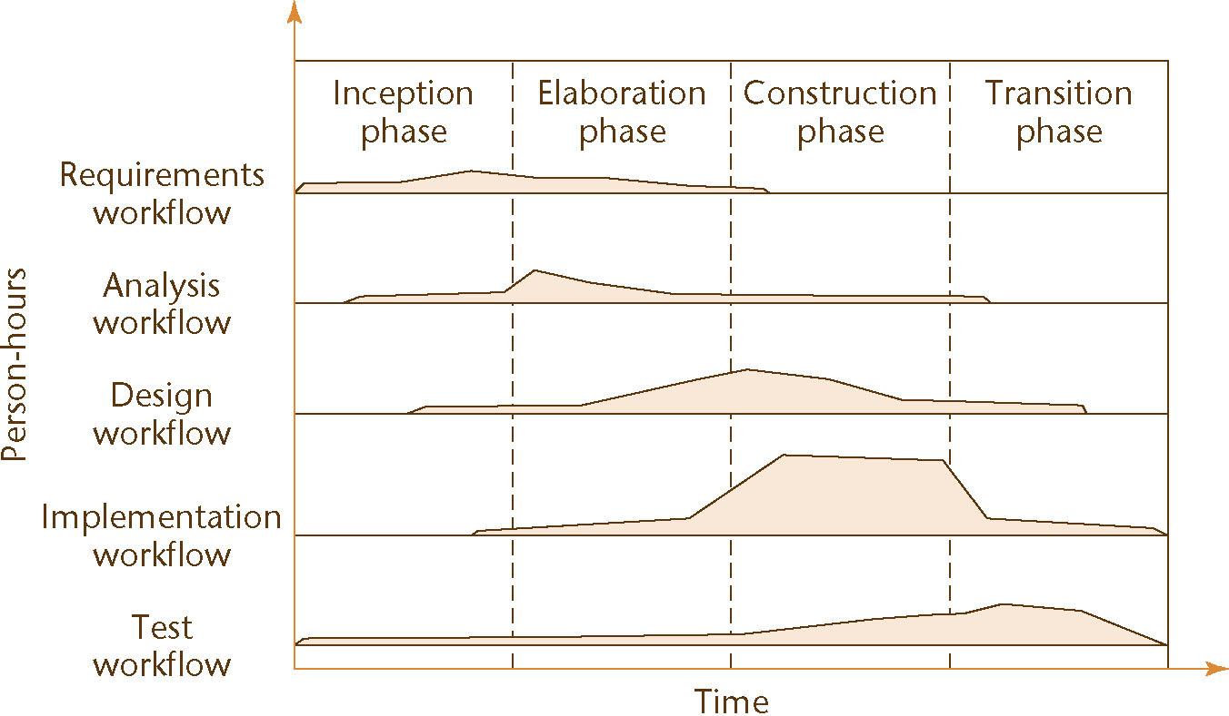
Determining What the Client Needs (contd)
The solution:
  Obtain initial information from the client
  Use this initial information as input to the Unified Process
  Follow the steps of the Unified Process to determine the client’s real needs

Slide 8
Overview of the Requirements Workflow
First, gain an understanding of the application domain (or domain, for short)
  The specific environment in which the target product is to operate
Second, build a business model
  Model the client’s business processes
Third, use the business model to determine the client’s requirements
Iterate the above steps

Slide 9
Definitions
Discovering the client’s requirements
  Requirements elicitation (or requirements capture)
  Methods include interviews and surveys
Refining and extending the initial requirements
  Requirements analysis

Slide 10
Understanding the Domain
Every member of the development team must become fully familiar with the application domain
  Correct terminology is essential
Construct a glossary
  A list of technical words used in the domain, and their meanings

Slide 11
Business Model
A business model is a description of the business processes of an organization
The business model gives an understanding of the client’s business as a whole
  This knowledge is essential for advising the client regarding computerization
The systems analyst needs to obtain a detailed understanding of the various business processes
  Different techniques are used, primarily interviewing

Slide 12
Interviewing
The requirements team meet with the client and users to extract all relevant information

Slide 13
Interviewing (contd)
There are two types of questions
  Close-ended questions require a specific answer
  Open-ended questions are posed to encourage the person being interviewed to speak out
There are two types of interviews
  In a structured interview, specific preplanned questions are asked, frequently close-ended
  In an unstructured interview, questions are posed in response to the answers received, frequently open-ended

Slide 14
Interviewing (contd)
Interviewing is not easy
  An interview that is too unstructured will not yield much relevant information
  The interviewer must be fully familiar with the application domain
  The interviewer must remain open-minded at all times
After the interview, the interviewer must prepare a written report
  It is strongly advisable to give a copy of the report to the person who was interviewed

Slide 15
Other Techniques
Interviewing is the primary technique
A questionnaire is useful when the opinions of hundreds of individuals need to be determined
Examination of business forms shows how the client currently does business

Slide 16
Other Techniques (contd)
Direct observation of the employees while they perform their duties can be useful
  Videotape cameras are a modern version of this technique
  But, it can take a long time to analyze the tapes
  Employees may view the cameras as an unwarranted invasion of privacy

Slide 17
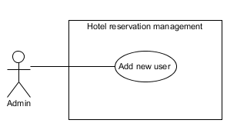
Use Cases
A use case models an interaction between the software product itself and the users of that software product (actors)
Example:
Figure 10.1

Slide 18
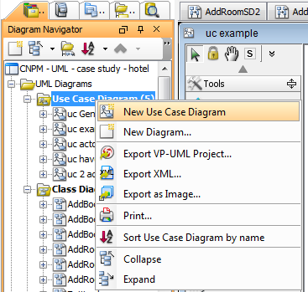
Use Cases (contd)
In VP, select new use case diagram:
Figure 10.1

Slide 19
Actor
An actor is a member of the world outside the software product
It is usually easy to identify an actor
  An actor is frequently a user of the software product
In general, an actor plays a role with regard to the software product. This role is
  As a user; or
  As an initiator; or
  As someone who plays a critical part in the use case

Slide 20
Actor (contd)
A user of the system can play more than one role
Example: A customer of the bank can be
  A Borrower or
  A Lender

Slide 21
Actor (contd)
Conversely, one actor can be a participant in multiple use cases
Example: A Borrower may be an actor in
  The Borrow Money use case;
  The Pay Interest on Loan use case; and
  The Repay Loan Principal use case
Also, the actor Borrower may stand for many thousands of bank customers

Slide 22
Actor (contd)
An actor need not be a human being
Example: An e-commerce information system has to interact with the credit card company information system
  The credit card company information system is an actor from the viewpoint of the e-commerce information system
  The e-commerce information system is an actor from the viewpoint of the credit card company information system

Slide 23
Actor (contd)
A potential problem when identifying actors
  Overlapping actors
Example: Hospital software product
  One use case has actor Nurse
  A different use case has actor Medical Staff
  Better:
    Actors: Physician and Nurse

Slide 24
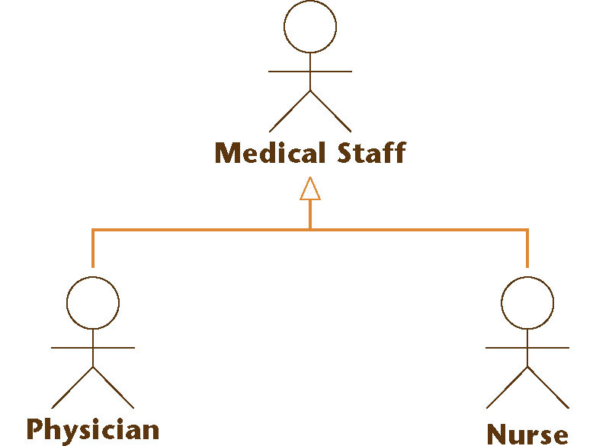
Actor (contd)
Alternatively:
  Actor Medical Staff with two specializations: Physician and Nurse
Figure 10.2

Slide 25
Use case (contd)
Three relationships between use cases:
  Include
  Extend
  Genelization
Figure 10.2

Slide 26
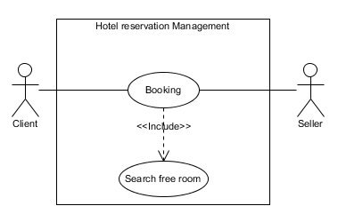
Use case (contd)
Include relationship:
  UC A includes UC B if action B is a part of action A
  Each time realise A, the actor also has to realise B
  If not finish B, the actor can not finish A.
Ex: booking a room includes searching for available room.
Figure 10.2

Slide 27
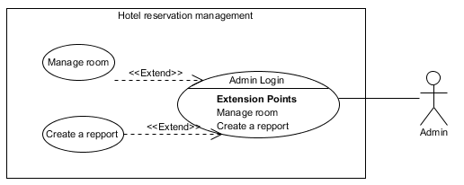
Use case (contd)
Extend relationship:
  UC B extends from UC A if action B could be relalised from action A
  Doing B is optional while doing A
  If not finish B, the actor can still finish A.
Ex: Manage a room or view repport are extened from login of admin.
Figure 10.2

Slide 28
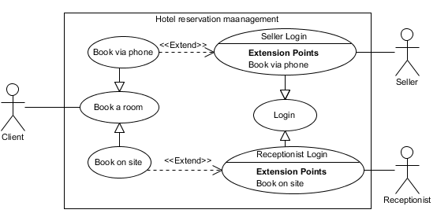
Use case (contd)
Genelization relationship:
  UC B inherites from UC A if action B is an instance of action A
  The logic of doing B is similar to that of doing A
Ex: Booking a room via phone and booking at the counter are the same and a they are a kind of booking in genaral.
Figure 10.2

Slide 29
Initial Requirements
The initial requirements are based on the initial business model
Then they are refined
The requirements are dynamic — there are frequent changes
  Maintain a list of likely requirements, together with use cases of requirements approved by the client

Slide 30
Initial Requirements (contd)
There are two categories of requirements
A functional requirement specifies an action that the software product must be able to perform
  Often expressed in terms of inputs and outputs
A nonfunctional requirement specifies properties of the software product itself, such as
  Platform constraints
  Response times
  Reliability

Slide 31
Initial Requirements (contd)
Functional requirements are handled as part of the requirements and analysis workflows
Some nonfunctional requirements have to wait until the design workflow
  The detailed information for some nonfunctional requirements is not available until the requirements and analysis workflows have been completed

Slide 32
CASE STUDY
Hotel reservation management software
HOTEL RESERVATION MANAGEMENT SYSTEM

Slide 33
Requirement process
Concept exploration
  Collect terms/concepts in the domain
  Build the glossary list
Business model by natural language
  Scope and objective
  Who can use the software? What are functions that an actor can do?
  How does each function work?
  Which information/object the system need to process?
  Relationship among objects?

Slide 34
Requirement process (contd)
Business model by technical language - UML
  Identify actors of the system
  Identify use cases for each actor
  Refine the general use case diagram of the system
  Detail use case diagram for each function

Slide 35
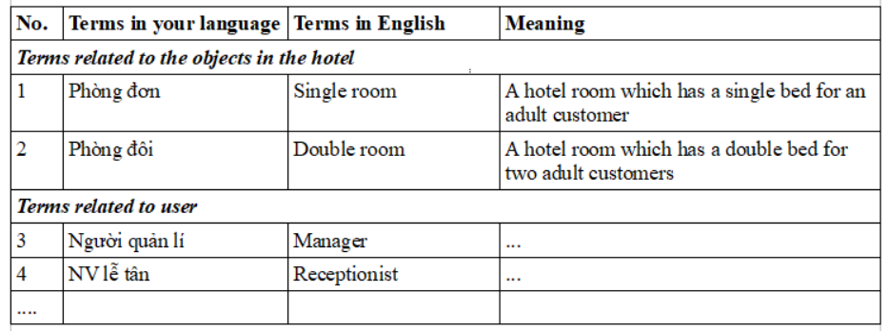
HRM: concept exploration
Step 1: Use brain storming to discover terms/concepts in the application domain
  Ex: room, single room, double room, booking...
Step 2: Build the glossary list
  Grouped by its category
  Indexed continuously among groups

Slide 36
HRM: BM by natural language
Objective
  A desktop application enablings to manage the reservation of a single hotel

Slide 37
HRM: BM by natural language (contd)
Scope
  Used within a hotel (could be on many computers)
  Only following employees of the hotel could use:
    Manager
    System admin
    Seller
    Receptionist
  Only following functions are enabled:
    Management of hotel, room, user information
    Booking room, cancel booking,
    Checkin, checkout and payment
    View statistical repports related to booking
  The users which are not mentioned have no right to use
  The functions which are not mentioned are not available

Slide 38
HRM: BM by natural language (contd)
Who could do what in the system?
  Manager
    Manage hotel infor: add, edit, delete, search and view
    Manage room infor: add, edit, delete, search/view
    View statistical repports: income by room/client/month
  Admin (by the requirement form the related user)
    Manage user infor: add, edit, delete, search/view
  Seller (by the requirement of customers)
    Search and book room via phone
    Cancel room via phone
  Receptionist (by the requirement of customers)
    Search and book room at the counter desk
    Cancel room at the counter desk
    Checkin for a client
    Checkout/ payment process for a client

Slide 39
HRM: BM by natural language (contd)
How does each function work?
  Edit a room
    A manager logged in → Manager home UI shown with menu to select to: manage hotel, manage room, view statistic
    Select manage room → Room management UI shown with menu to select to: add, edit, delete, search
    Select edit room → Room search UI shown with a textbox to enter keyword, a earch button
    Enter a keyword + click search → Search results UI shown with a list of room whose name contains the entered keyword. Each raw associated to buttons of edit, delete

Slide 40
HRM: BM by natural language (contd)
How does each function work?
  Edit a room (contd)
    Select edit a row → Edit room UI shown with textfields: name, type, price, description which are already filled by the information of the selected room, buttons: save, reset.
    Edit some fields + click save → The successful message shown.
    Click OK of the message → Return to the Manager home UI.

Slide 41
HRM: BM by natural language (contd)
Objects need to be processed
  Hotel:
    Name, address, star rating, décription
  Room:
    Name, type, price, description
  User:
    Username, password, fullname, role
  Client:
    Name, address, tel, email, note
  Bill:
    Client's infor, Creator's infor, booking infor, service infor
  Service:
    Name, category, unity, price, description
  ...

Slide 42
HRM: BM by natural language (contd)
Relationships among objects
  A hotel could have 1 or many rooms
  A client could book many times, each time many rooms
  A room could be booked many time at different periods
  A service could be used many time in each booked room
  Each booked time, a room could use 0 or many service
  Each booked time, a client could pay many times, each time receives a bill
  ...

Slide 43
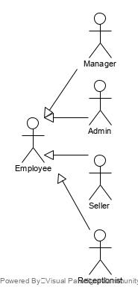
HRM: BM by technical language - UML
Identification of actors
  Manager
  Admin
  Seller
  Receptionist
  Thay are hotel employee → create an abstract actor of hotel employee
  Client : indirect actor

Slide 44
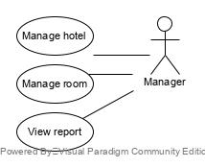
HRM: BM by technical language - UML(contd)
Identification of use case
  Manager
    Manage hotel infor
    Manage room infor
    View statistics

Slide 45
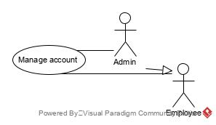
HRM: BM by technical language - UML(contd)
Identification of use case
  Admin
    Manage user account (by the user's requirement)

Slide 46
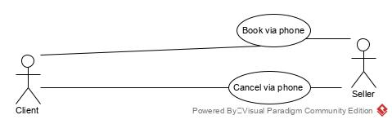
HRM: BM by technical language - UML(contd)
Identification of use case
  Seller
    Booking via phone (by the client's requirement)
    Cancel via phone (by the client's requirement)

Slide 47
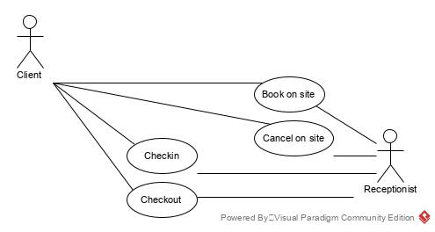
HRM: BM by technical language - UML(contd)
Identification of use case
  Receptionist
    Booking on site (at the counter by the client's requirement)
    Cancel on site (at the counter by the client's requirement)
    Checkin (by the client's requirement)
    Checkout (by the client's requirement)

Slide 48
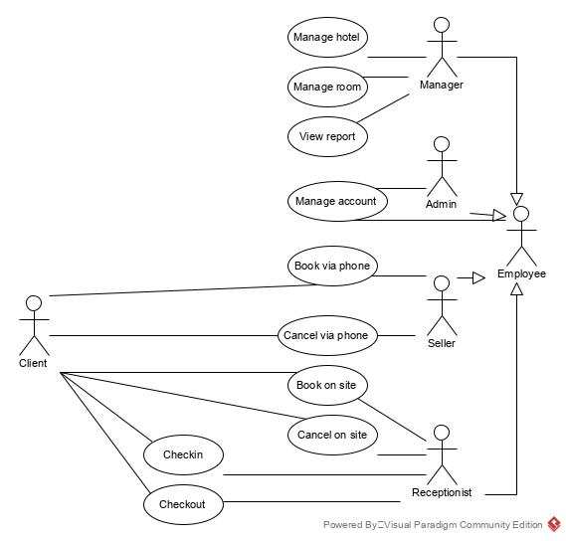
HRM: BM by technical language - UML(contd)
Identification of use case
  All initial use cases

Slide 49
HRM: BM by technical language - UML(contd)
Refine use case
  Booking via phone and booking on site are the same → create an abstract UC of Booking
  Cancel via phone and cancel on site are the same → create an abstract UC of Cancel

Slide 50
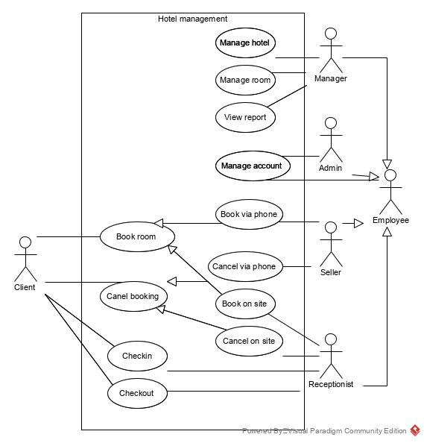
HRM: BM by technical language - UML(contd)
Refine use case
  General UC diagram

Slide 51
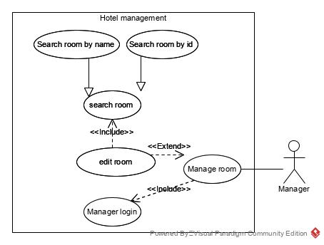
HRM: BM by technical language - UML(contd)
Detail use case
  Edit room
    Is a sub UC of manage room (optional select from it) → extend from manage room
    Must login (for all manage room) → include by manage room
    Must search room to edit → include by edit room

Slide 52
HRM: BM by technical language - UML(contd)
Detail use case
  Booking room
    Reuse the relationships from reneral diagram
    Must login (seller or receptionist) → include
    Must search available room → include
    Must search client → include
    If new client → add new (sometimes only) → extend

Slide 53
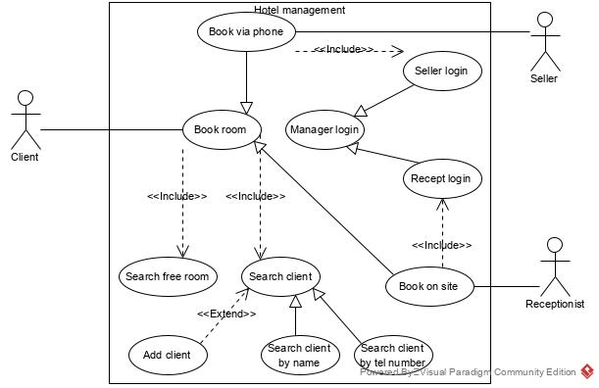
HRM: BM by technical language - UML(contd)
Detail use case
  Booking room

Slide 54
HRM: BM by technical language - UML(contd)
Detail use case
  … continue with all remain use cases

Slide 55
CHAPTER 10
End of requirement
(except review and correct errors)

